Slide 1


Slide 2
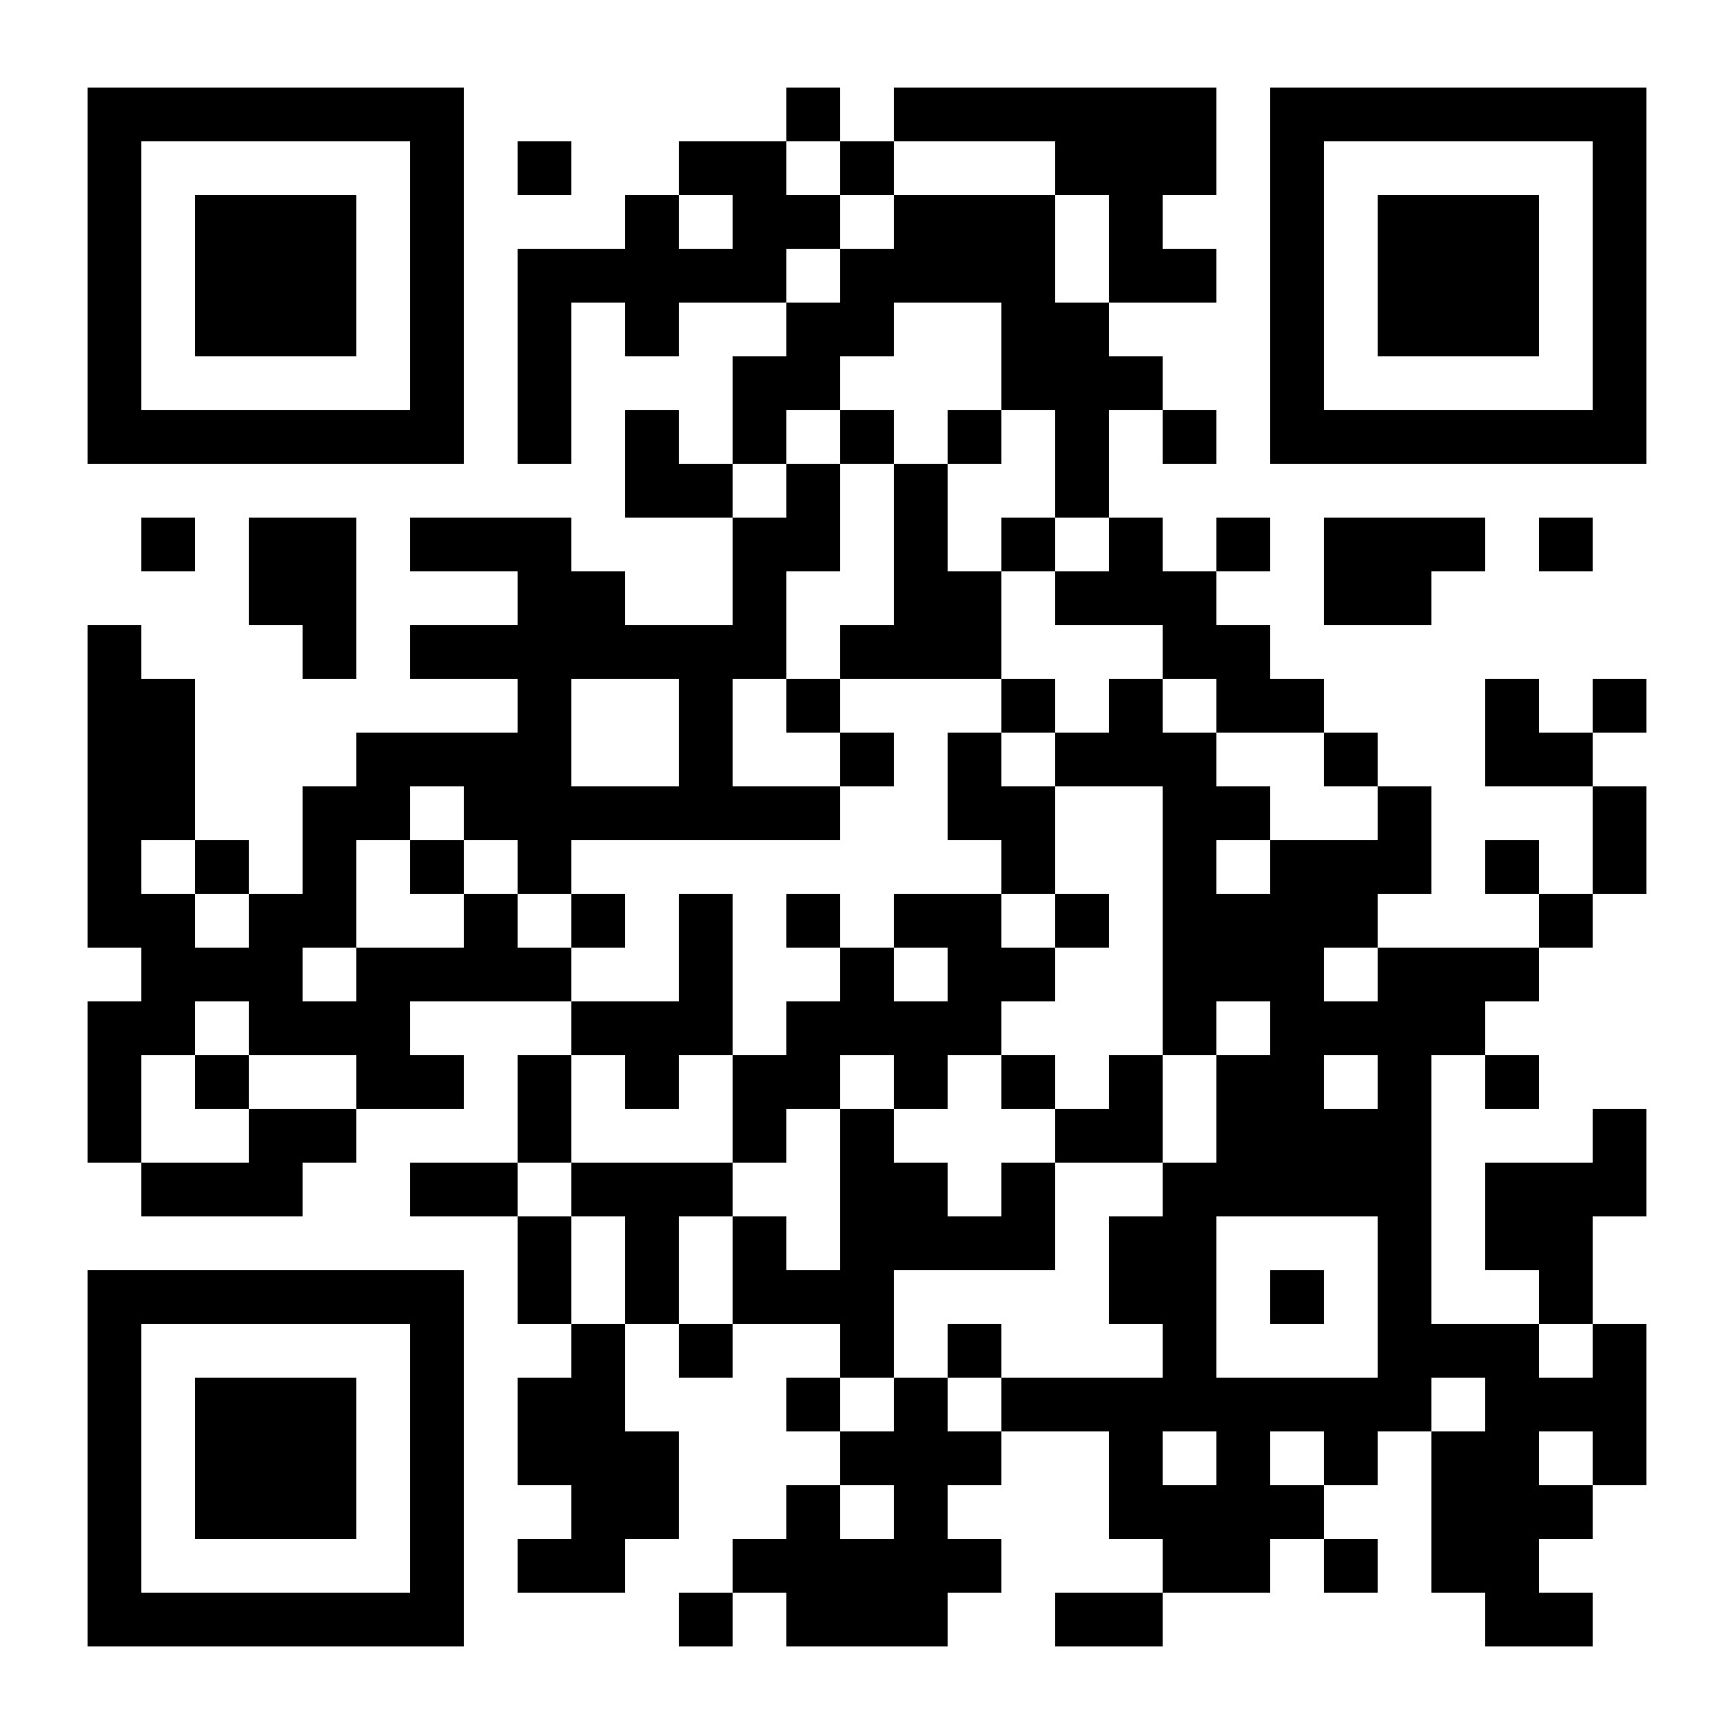
Become a Project Creator!

Slide 3
Upcoming Workshop
Teaching with Social Annotation
November 12, 11am – 12:30pm, Zoom
Social annotation offers an interactive way to “open up” a text, allowing students to contribute highlights, comments, and responses directly in the margins. This transforms the text into a collaborative learning space for deeper analysis, interpretation, and enrichment. This workshop will introduce participants to two platforms for integrating social annotation into their courses: Manifold and Hypothesis on CUNY Academic Commons.
https://tlc.commons.gc.cuny.edu/2024/09/23/fall-2024-tlc-workshops/

Slide 4
Stay Connected!
Emails:
Robin Miller: rmiller2@gc.cuny.edu
Maura McCreight: mmccreight@gradcenter.cuny.edu
Cen Liu: cliu5@gradcenter.cuny.edu
Follow Us:
CUNY Academic Commons Group: CUNY Manifold Users
Instagram: @cunymanifold

