Slide 1


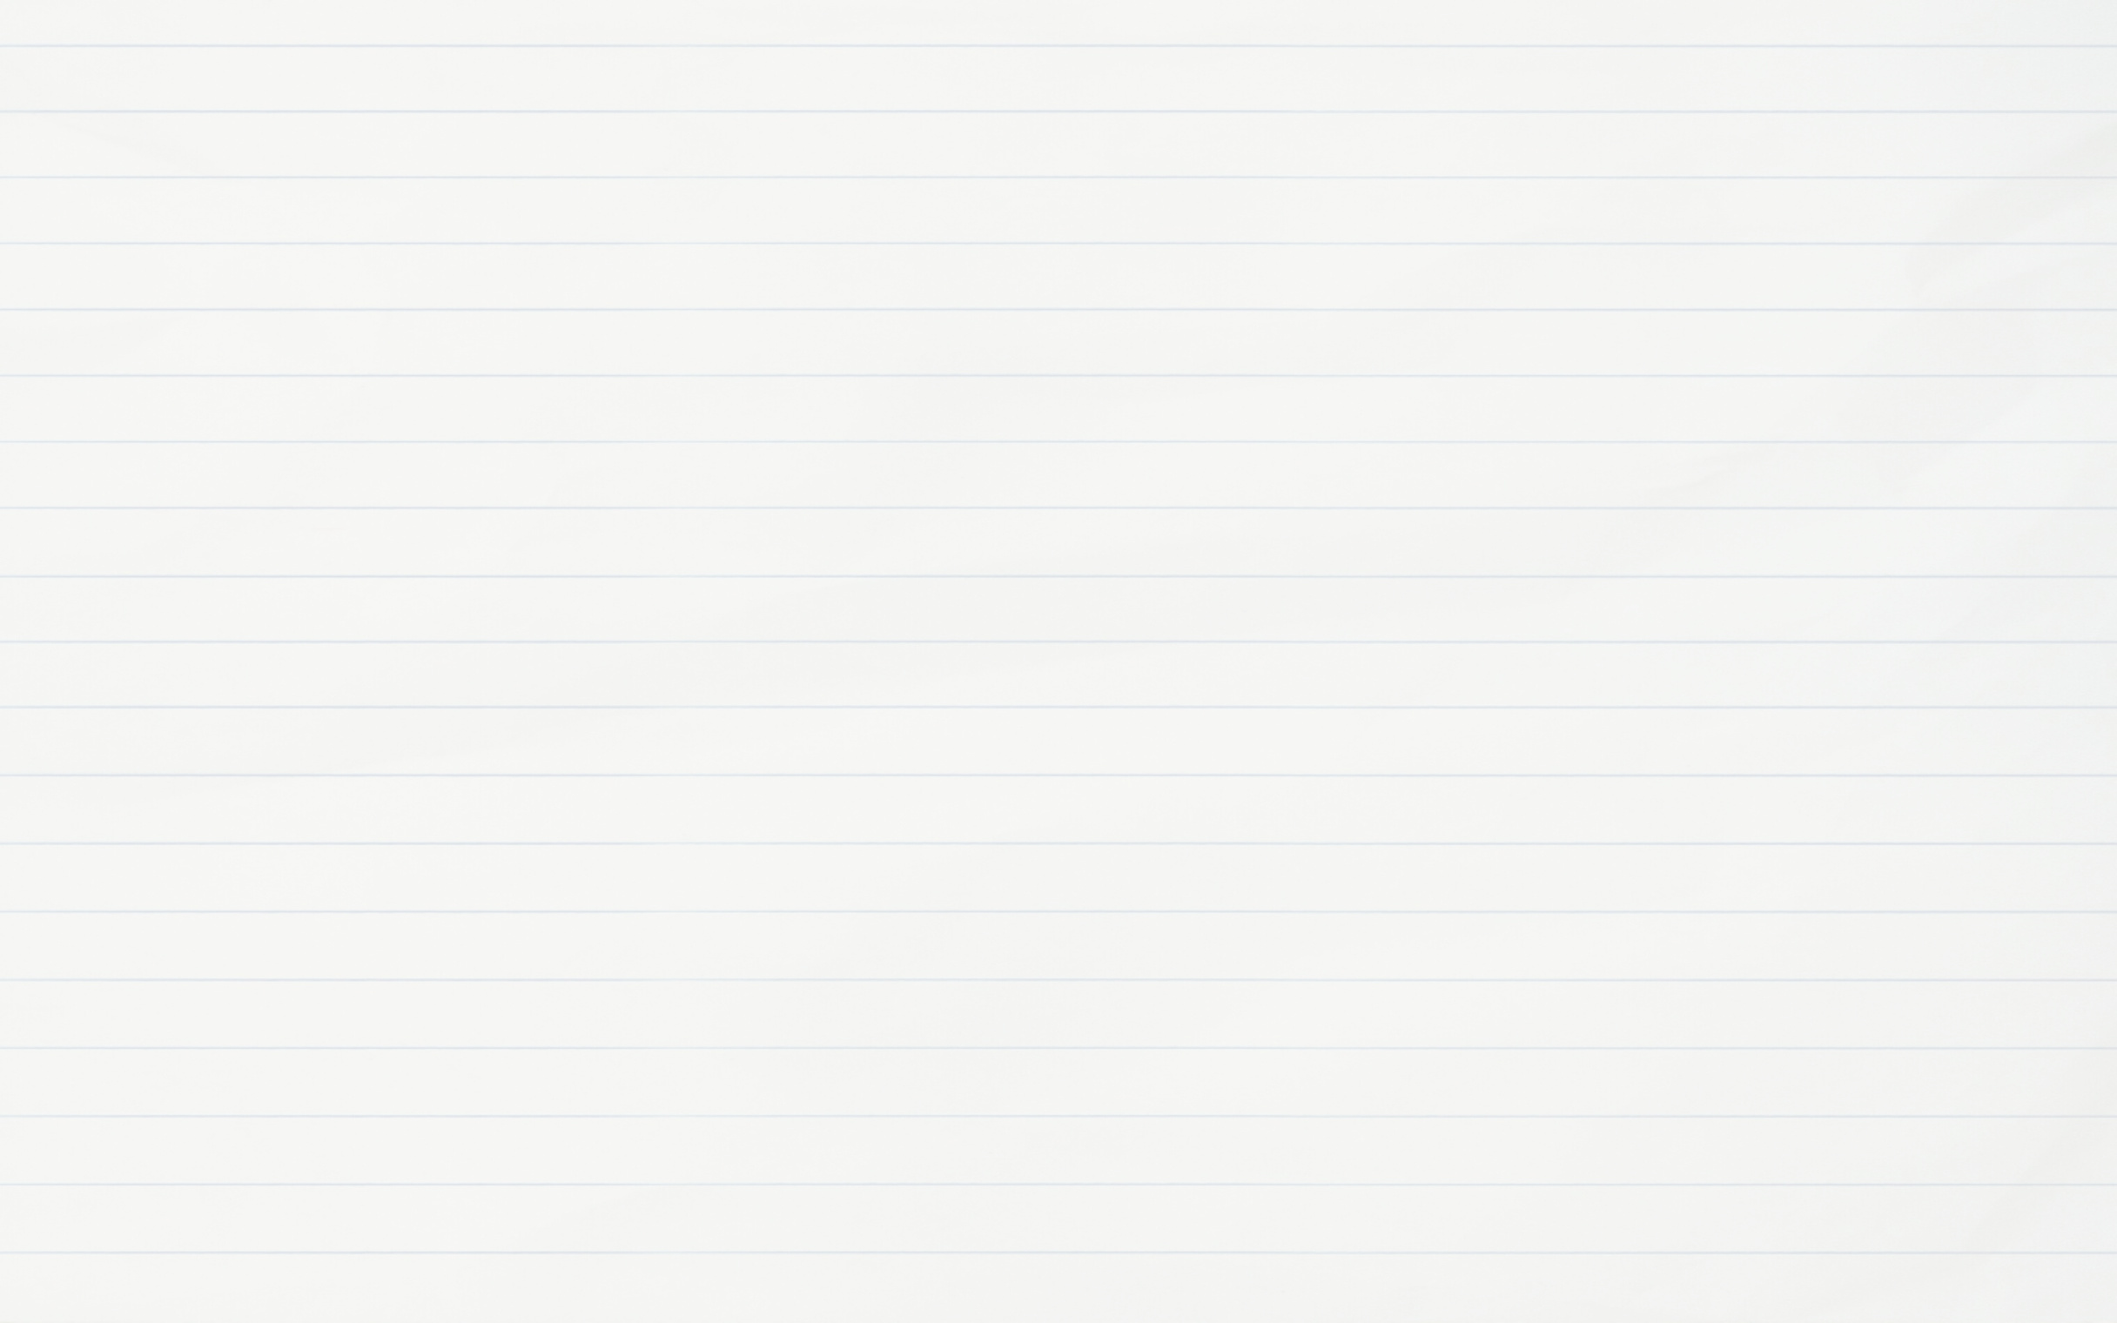




Students as Learners, Teachers & Creators:
The Spanish Fantastic Through Open Pedagogy
Juan Jesús Payán
Lehman College, CUNY

Slide 2





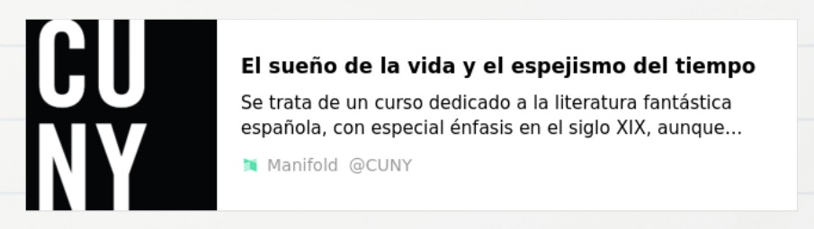
The Theme Proposed Was the Illusion of Time and Death
Project/Objectives
Students as Learners
Students as Teachers
Students as Creators
How to teach literature?
How to create editions for publication?
What is the Fantastic?
During the first couple of weeks, the instructor provided a theoretical and historical background of the Spanish Fantastic in the 19th Century. The instructor modeled how to teach a text and how to produce a pedagogical edition.
Students were assigned a short fantastic story. They were responsible to provide a lesson plan and teach the class (under the guidance of the professor). Their lesson plan was also used toward the creation of a pedagogical edition of the text.
Students were provided a model of a pedagogical edition of their text. They were responsible of the introduction of the author, the transcription of the text, footnotes, banks of questions, and bibliography. We produced an anthology of the Spanish Fantastic.

Slide 3
